Slide 1
Master Thesis Analogy
Johann Bock Severin

Slide 2
Towards Continuous Measurements
Johann Bock Severin
Time Evolution in Quantum Mechanics:
$$dρ=−i\left[H, ρ\right]dt+Σ_{n}𝒟\left[c_{n}\right]ρdt+Σ_{n}ℋ\left[c_{n}\right]ρdW$$

Slide 3
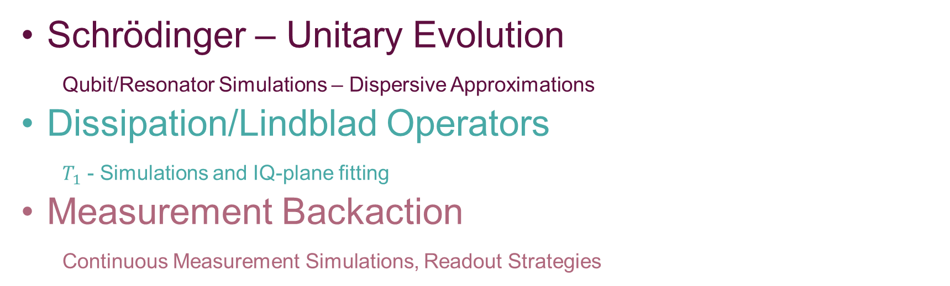
Towards Continuous Measurements
Johann Bock Severin
$$dρ=−i\left[H, ρ\right]dt+Σ_{n}𝒟\left[c_{n}\right]ρdt+Σ_{n}ℋ\left[c_{n}\right]ρdW$$
Schrödinger – Unitary Evolution
Qubit/Resonator Simulations – Dispersive Approximations
Dissipation/Lindblad Operators
$T_{1}$ - Simulations and IQ-plane fitting
Measurement Backaction
Continuous Measurement Simulations, Readout Strategies

Slide 4
Qubit – Resonator Interactions
$$dρ=−i\left[H, ρ\right]dt+Σ_{n}𝒟\left[c_{n}\right]ρdt+Σ_{n}ℋ\left[c_{n}\right]ρdW$$
$$H=Σ_{k}ω_{k}|k⟩⟨k|+ω_{r}a^{†}a+H_{drive}+H_{int}$$

Slide 5
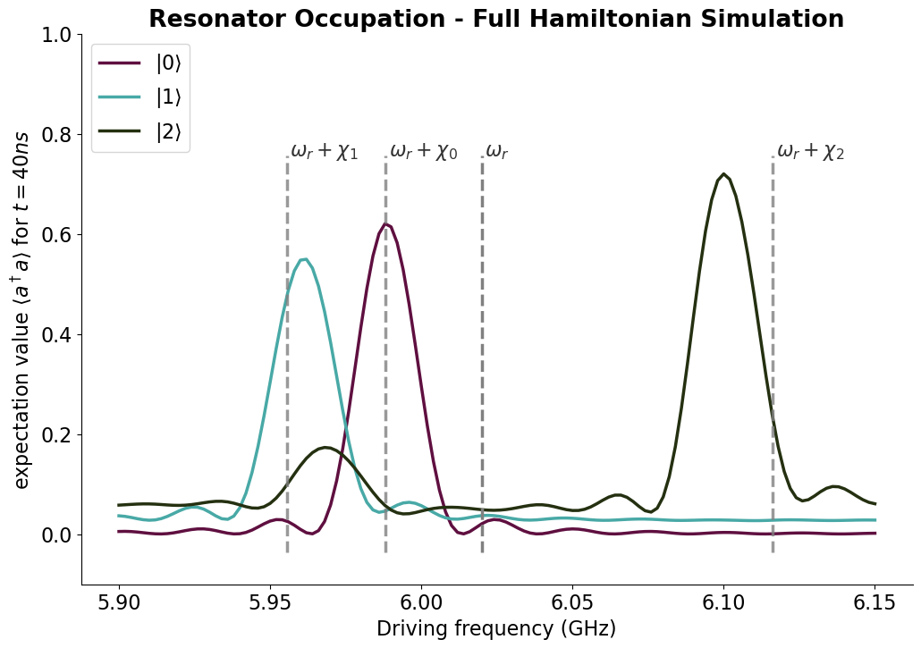
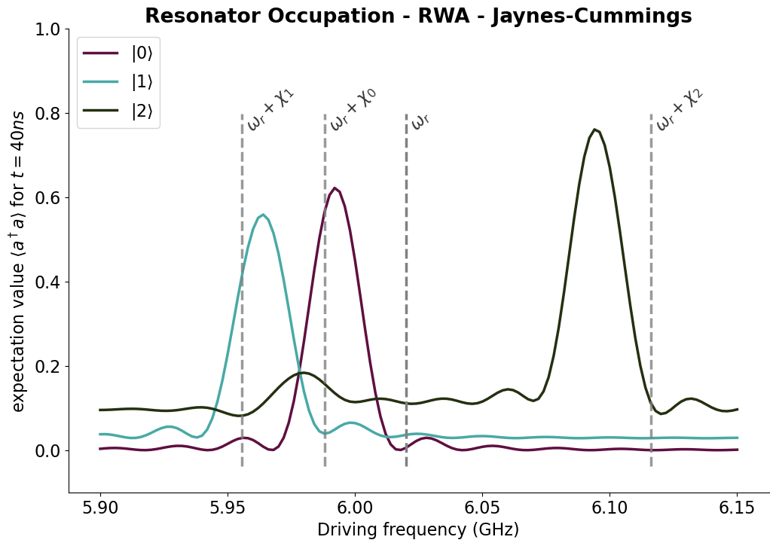
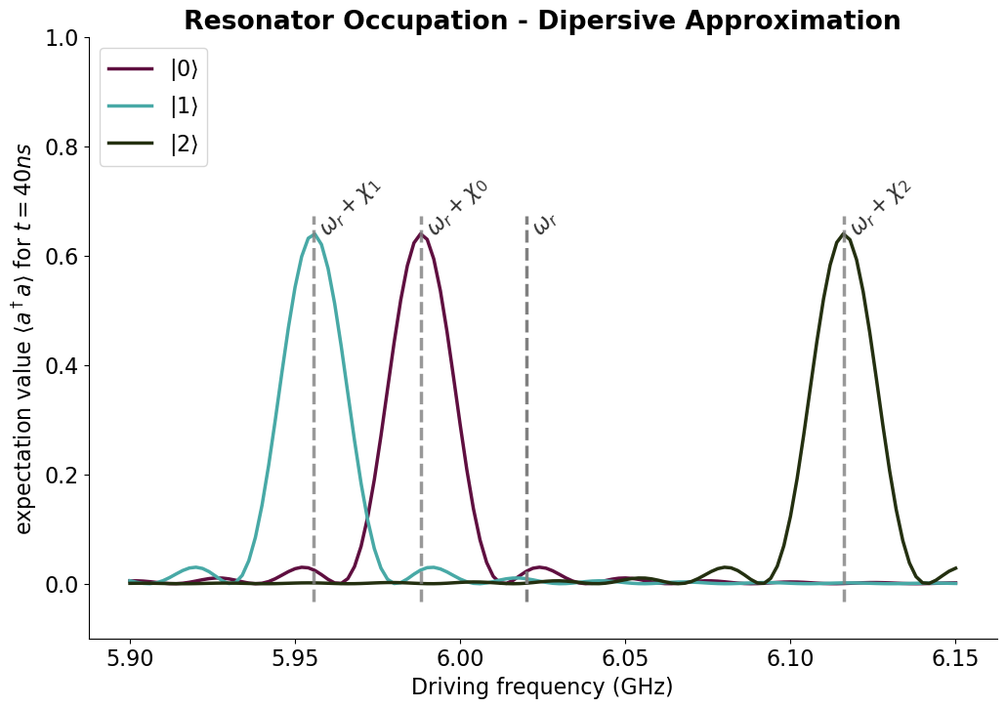
Qubit – Resonator Interactions
Different Interaction Approximations
$$dρ=−i\left[H, ρ\right]dt+Σ_{n}𝒟\left[c_{n}\right]ρdt+Σ_{n}ℋ\left[c_{n}\right]ρdW$$
$$H=Σ_{k}ω_{k}|k⟩⟨k|+ω_{r}a^{†}a+H_{drive}+H_{int}$$
$$H_{int}=Σ_{ij}g_{ij}\left|i\right\rangle \left\langle j\right|(a+a^{†})$$
$$H_{int}=g(σ_{−}a^{†}+σ_{+}a)$$
$$H_{0}+H_{int}=(ω_{r}+Σ_{k}χ_{k}\left|k\right\rangle \left\langle k\right|) a^{†}a$$

Slide 6

Lindblad Master Equation
Dissipative Evolution
$$dρ=−i\left[H, ρ\right]dt+Σ_{n}𝒟\left[c_{n}\right]ρdt+Σ_{n}ℋ\left[c_{n}\right]ρdW$$
$$𝒟\left[c\right]ρ=cρc^{†}−\frac{1}{2}(c^{†}cρ+ρc^{†}c)$$

Slide 7

Lindblad Master Equation
Dissipative Evolution
$$dρ=−i\left[H, ρ\right]dt+Σ_{n}𝒟\left[c_{n}\right]ρdt+Σ_{n}ℋ\left[c_{n}\right]ρdW$$
$$𝒟\left[c\right]ρ=cρc^{†}−\frac{1}{2}(c^{†}cρ+ρc^{†}c)$$
Collapse Operators.
For $c=σ_{−}→ρ=|1⟩⟨1|→|0⟩⟨0|$

Slide 8

Lindblad Master Equation
Dissipative Evolution
$$dρ=−i\left[H, ρ\right]dt+Σ_{n}𝒟\left[c_{n}\right]ρdt+Σ_{n}ℋ\left[c_{n}\right]ρdW$$
$$𝒟\left[c\right]ρ=cρc^{†}−\frac{1}{2}(c^{†}cρ+ρc^{†}c)$$
Normalization terms
Collapse Operators.
For $c=σ_{−}→ρ=|1⟩⟨1|→|0⟩⟨0|$

Slide 9
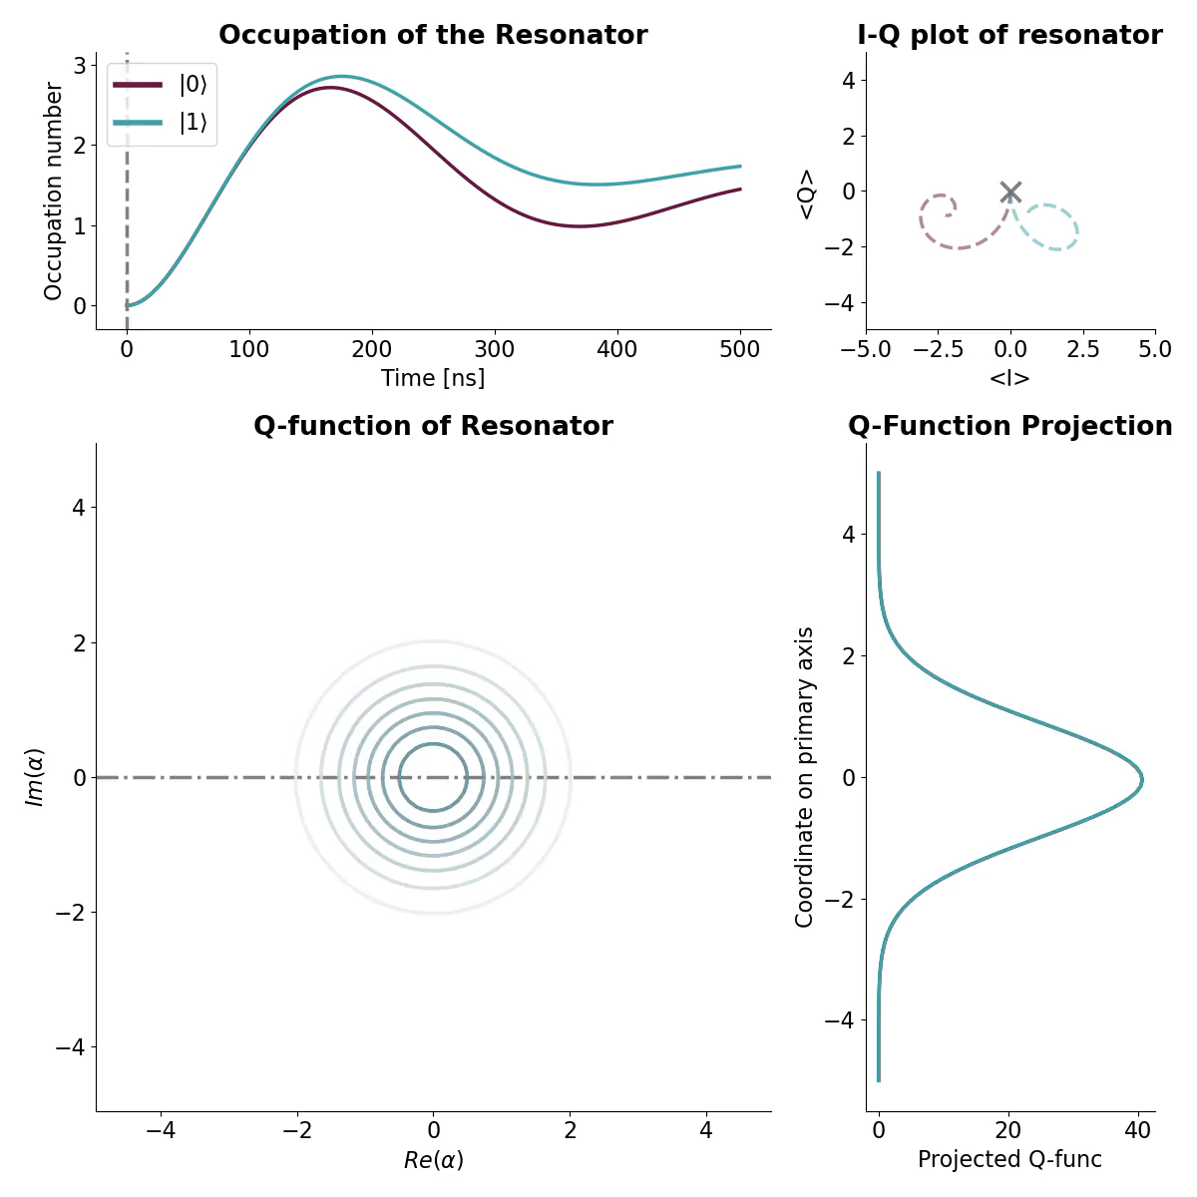

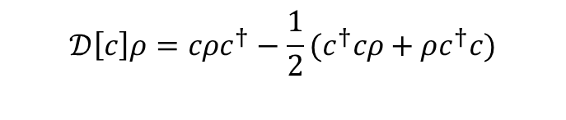
Lindblad Master Equation
Dissipative Evolution
$$dρ=−i\left[H, ρ\right]dt+Σ_{n}𝒟\left[c_{n}\right]ρdt+Σ_{n}ℋ\left[c_{n}\right]ρdW$$
$$𝒟\left[c\right]ρ=cρc^{†}−\frac{1}{2}(c^{†}cρ+ρc^{†}c)$$
$$c_{1}={\sqrt{Γ_{1}}σ}_{−}, c_{2}=\sqrt{κ}a$$
Possibilities:
Sampling of Data Points by Q-function
Use QFunc as PDF for fits
Separate SPAM-errors?

Slide 10
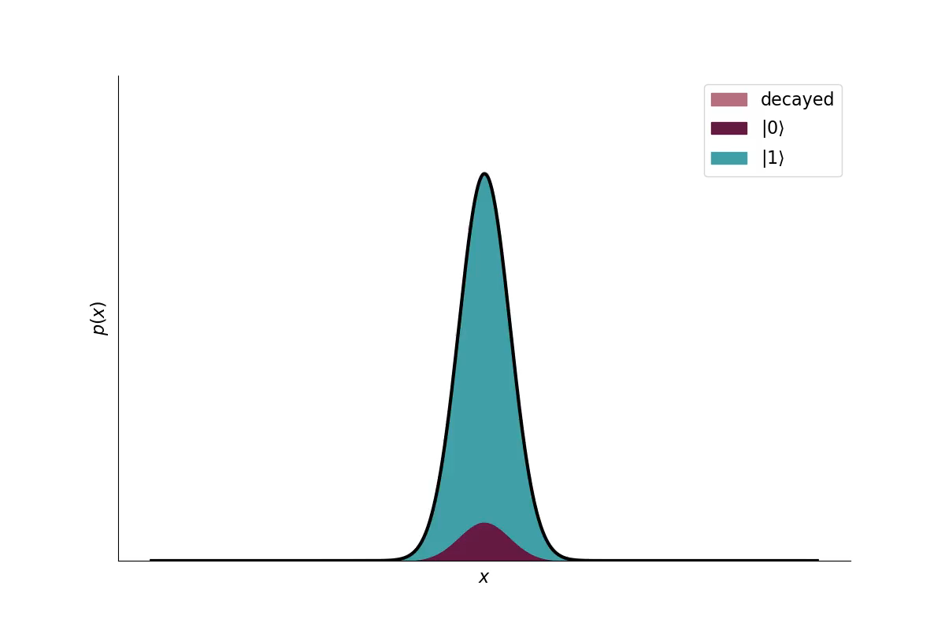
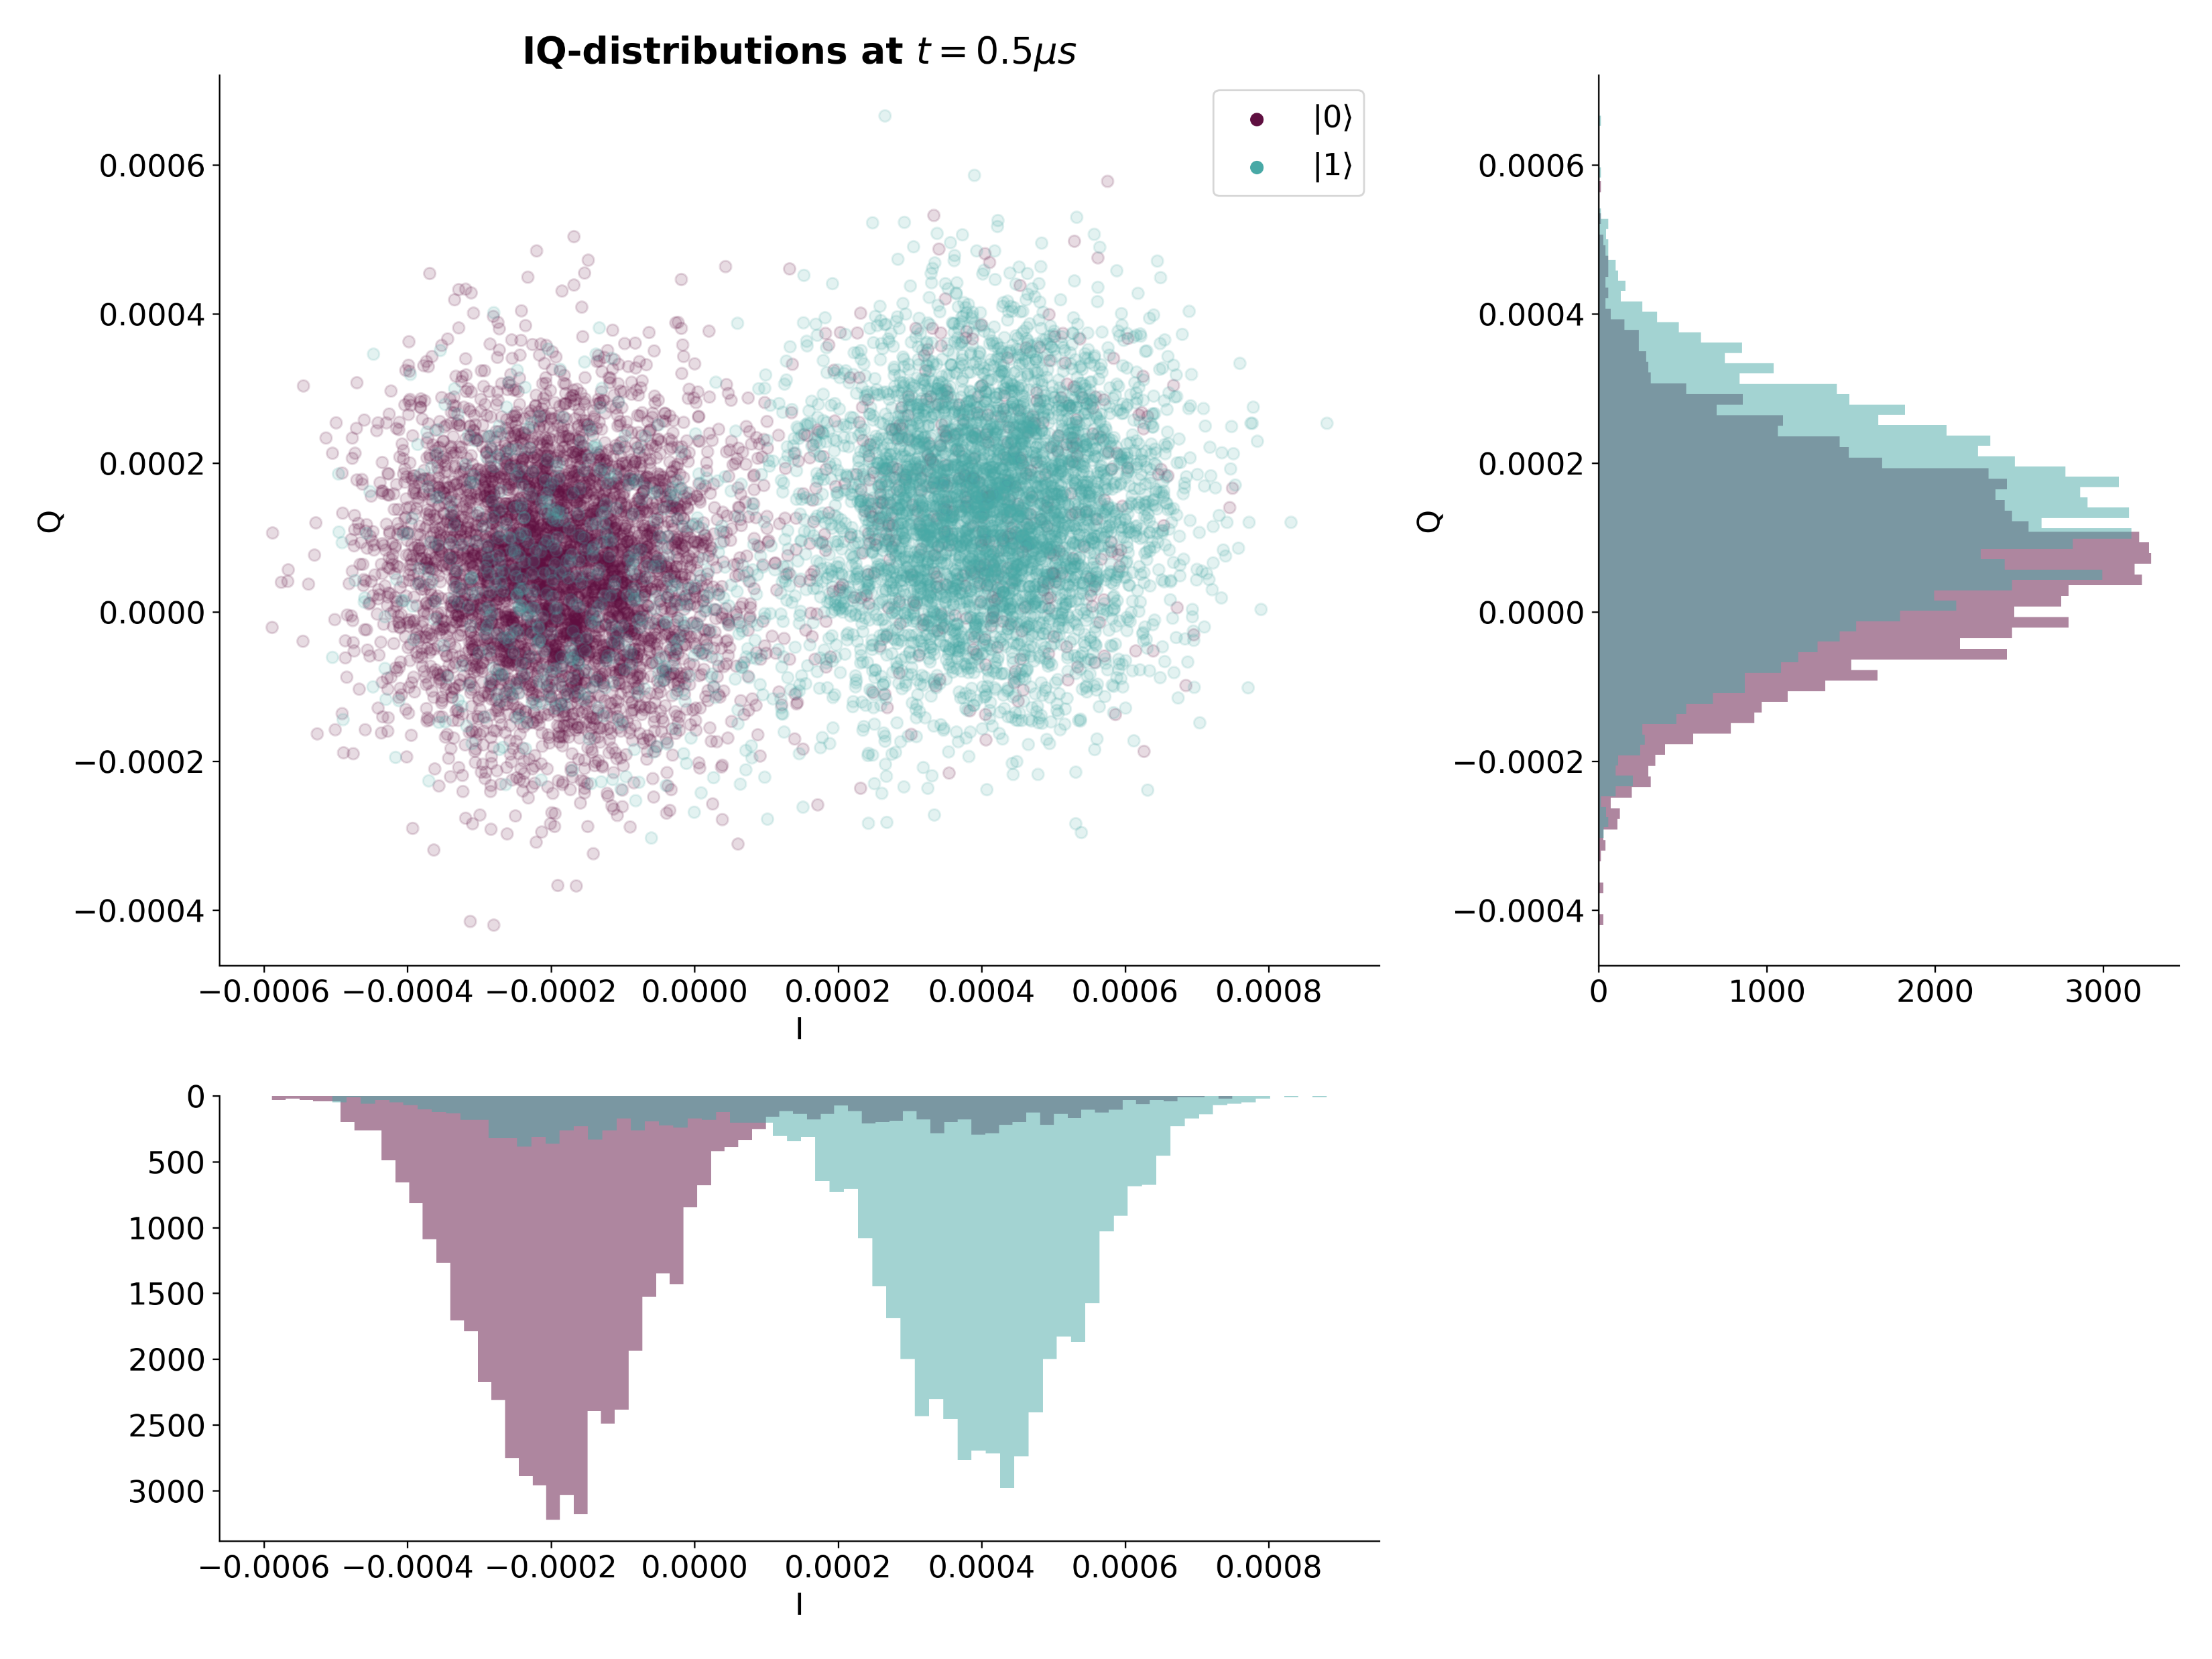
Calibration from IQ-Measurement
$$dρ=−i\left[H, ρ\right]dt+Σ_{n}𝒟\left[c_{n}\right]ρdt+Σ_{n}ℋ\left[c_{n}\right]ρdW$$

Slide 11
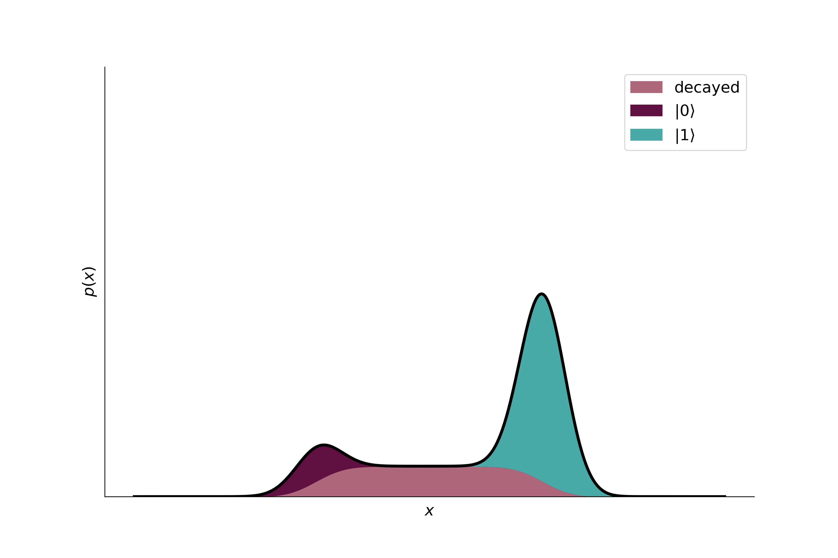
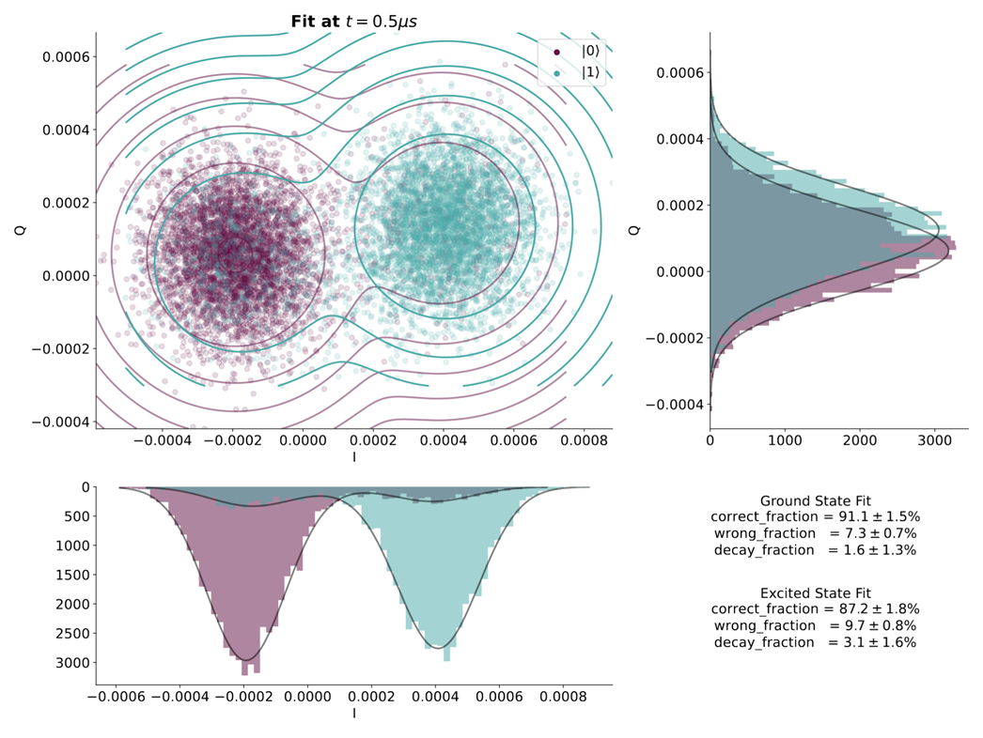
Calibration from IQ-Measurement
$$dρ=−i\left[H, ρ\right]dt+Σ_{n}𝒟\left[c_{n}\right]ρdt+Σ_{n}ℋ\left[c_{n}\right]ρdW$$

Slide 12
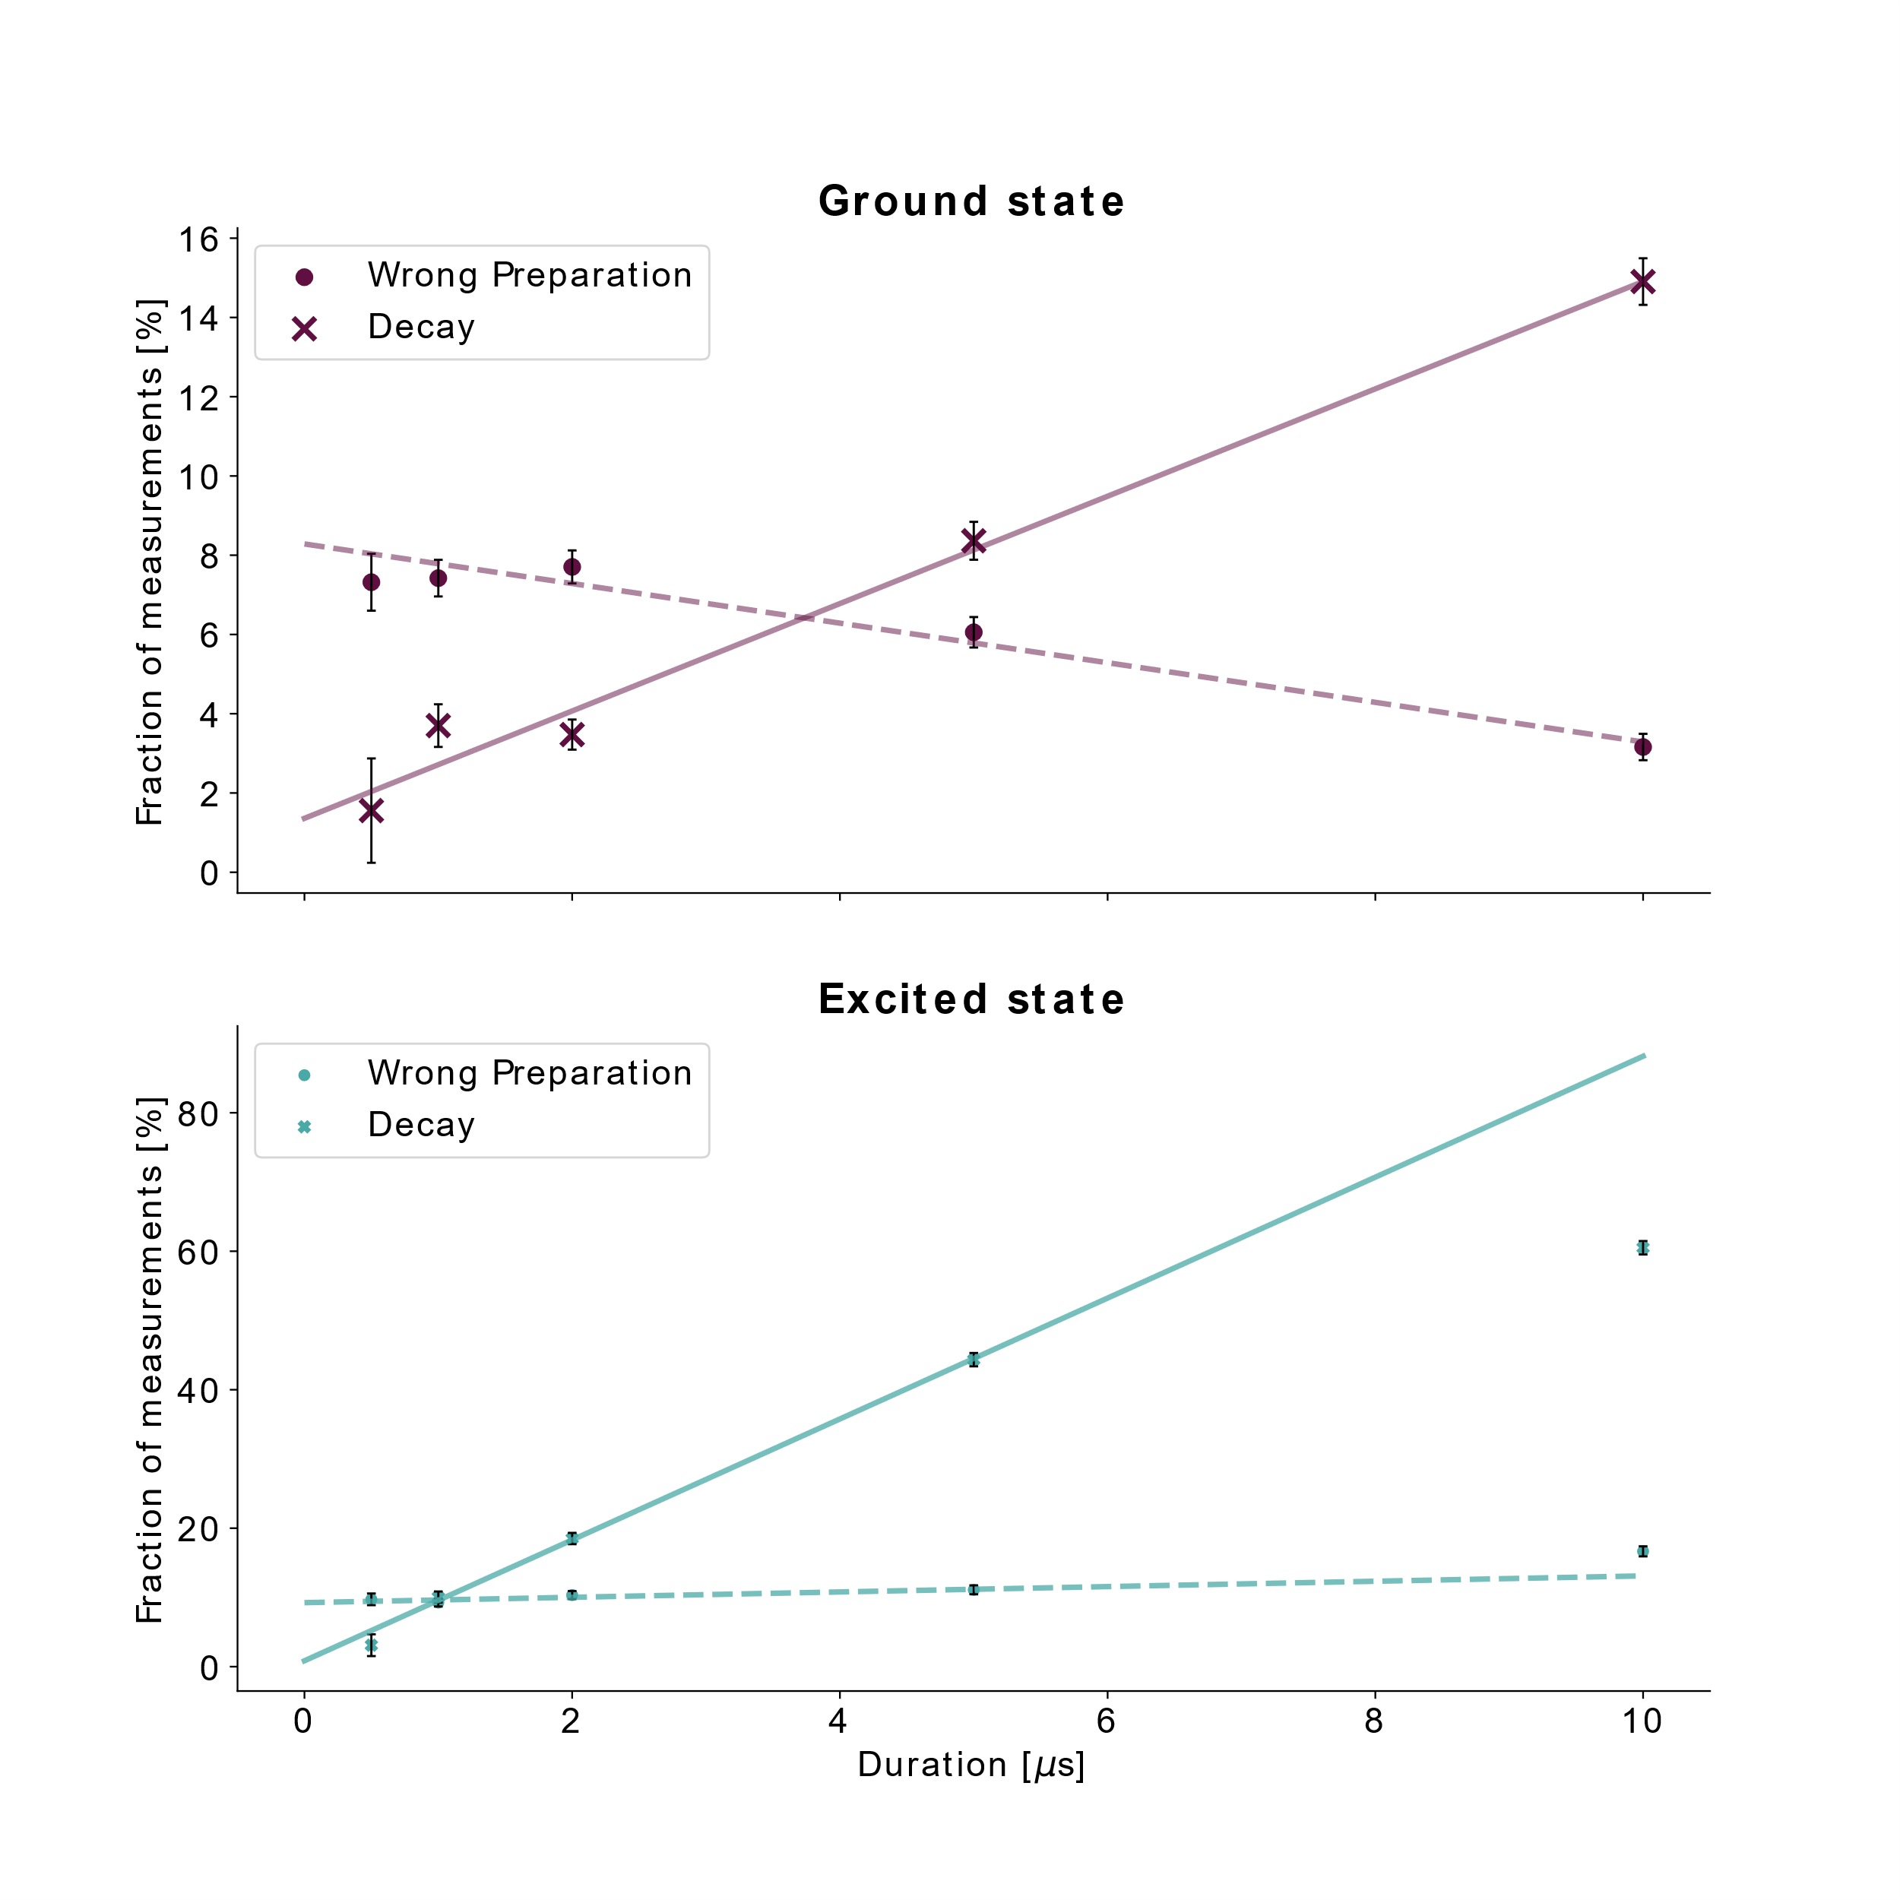
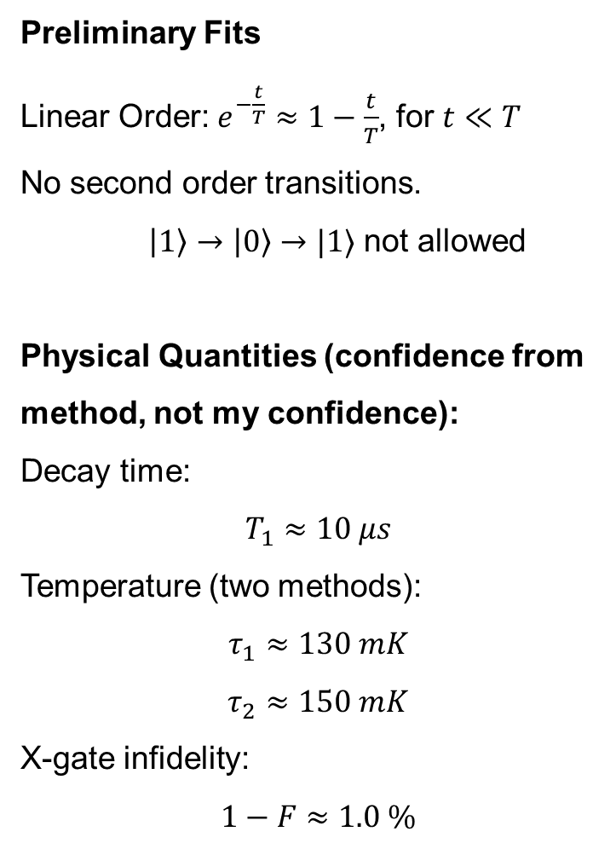
Calibration in IQ-Plane
Evolution
Preliminary Fits
Linear Order: $e^{−\frac{t}{T}}≈1−\frac{t}{T}$, for $t≪T$
No second order transitions.
$\left|1\right\rangle →\left|0\right\rangle →|1⟩$ not allowed
Physical Quantities (confidence from method, not my confidence):
Decay time:
$$T_{1}≈10 μs$$
Temperature (two methods):
$$τ_{1}≈130 mK$$
$$τ_{2}≈150 mK$$
X-gate infidelity:
$$1−F≈1.0 \%$$
$$dρ=−i\left[H, ρ\right]dt+Σ_{n}𝒟\left[c_{n}\right]ρdt+Σ_{n}ℋ\left[c_{n}\right]ρdW$$
Notes:
Physical Quantities (confidence from method, not my confidence):
Decay time:
$$T_{1}≈10 μs 9.9±0.3 μs$$
Temperature (two methods):
$$τ_{1}≈128±3 mK$$
$$τ_{2}≈154±5 mK$$
X-gate infidelity:
$$1−F≈1.0±0.6$$

Slide 13
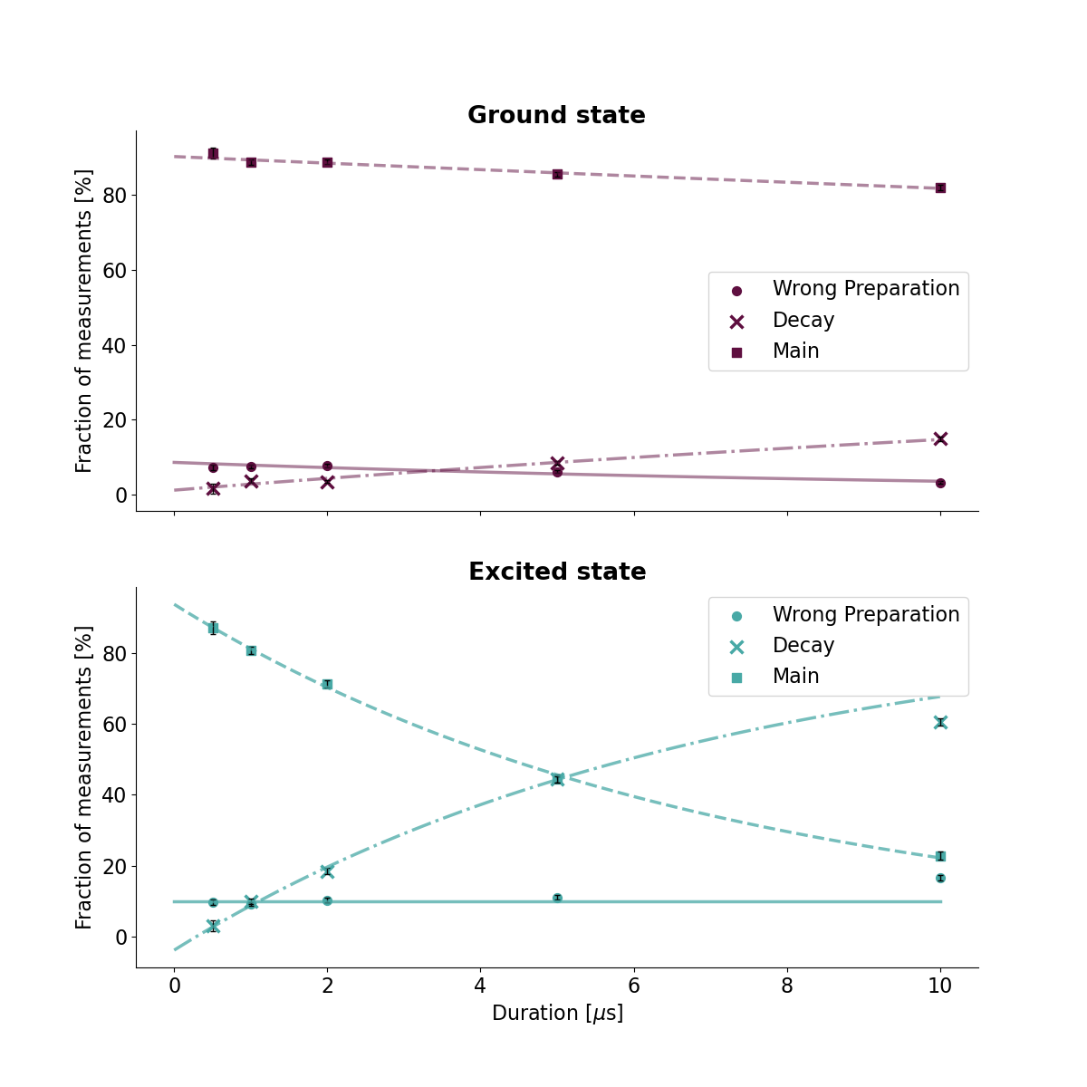
Calibration in IQ-Plane
Evolution
$$dρ=−i\left[H, ρ\right]dt+Σ_{n}𝒟\left[c_{n}\right]ρdt+Σ_{n}ℋ\left[c_{n}\right]ρdW$$
To do:
Exponential Fits
Calculate second order effects
Experiments
More data
“Calibration target” to test method

Slide 14

Stochastic Master Equation
Measurement Back-Action
$$dρ=−i\left[H, ρ\right]dt+Σ_{n}𝒟\left[c_{n}\right]ρdt+Σ_{n}ℋ\left[c_{n}\right]ρdW$$
$$ℋ\left[c\right]ρ=\sqrt{η}\left(cρ+ρc^{†}−\left\langle c+c^{†}\right\rangle ρ\right)$$
$$dr=\frac{\left\langle c+c^{†}\right\rangle }{2}dt+\frac{1}{2\sqrt{η}}dW$$

Slide 15
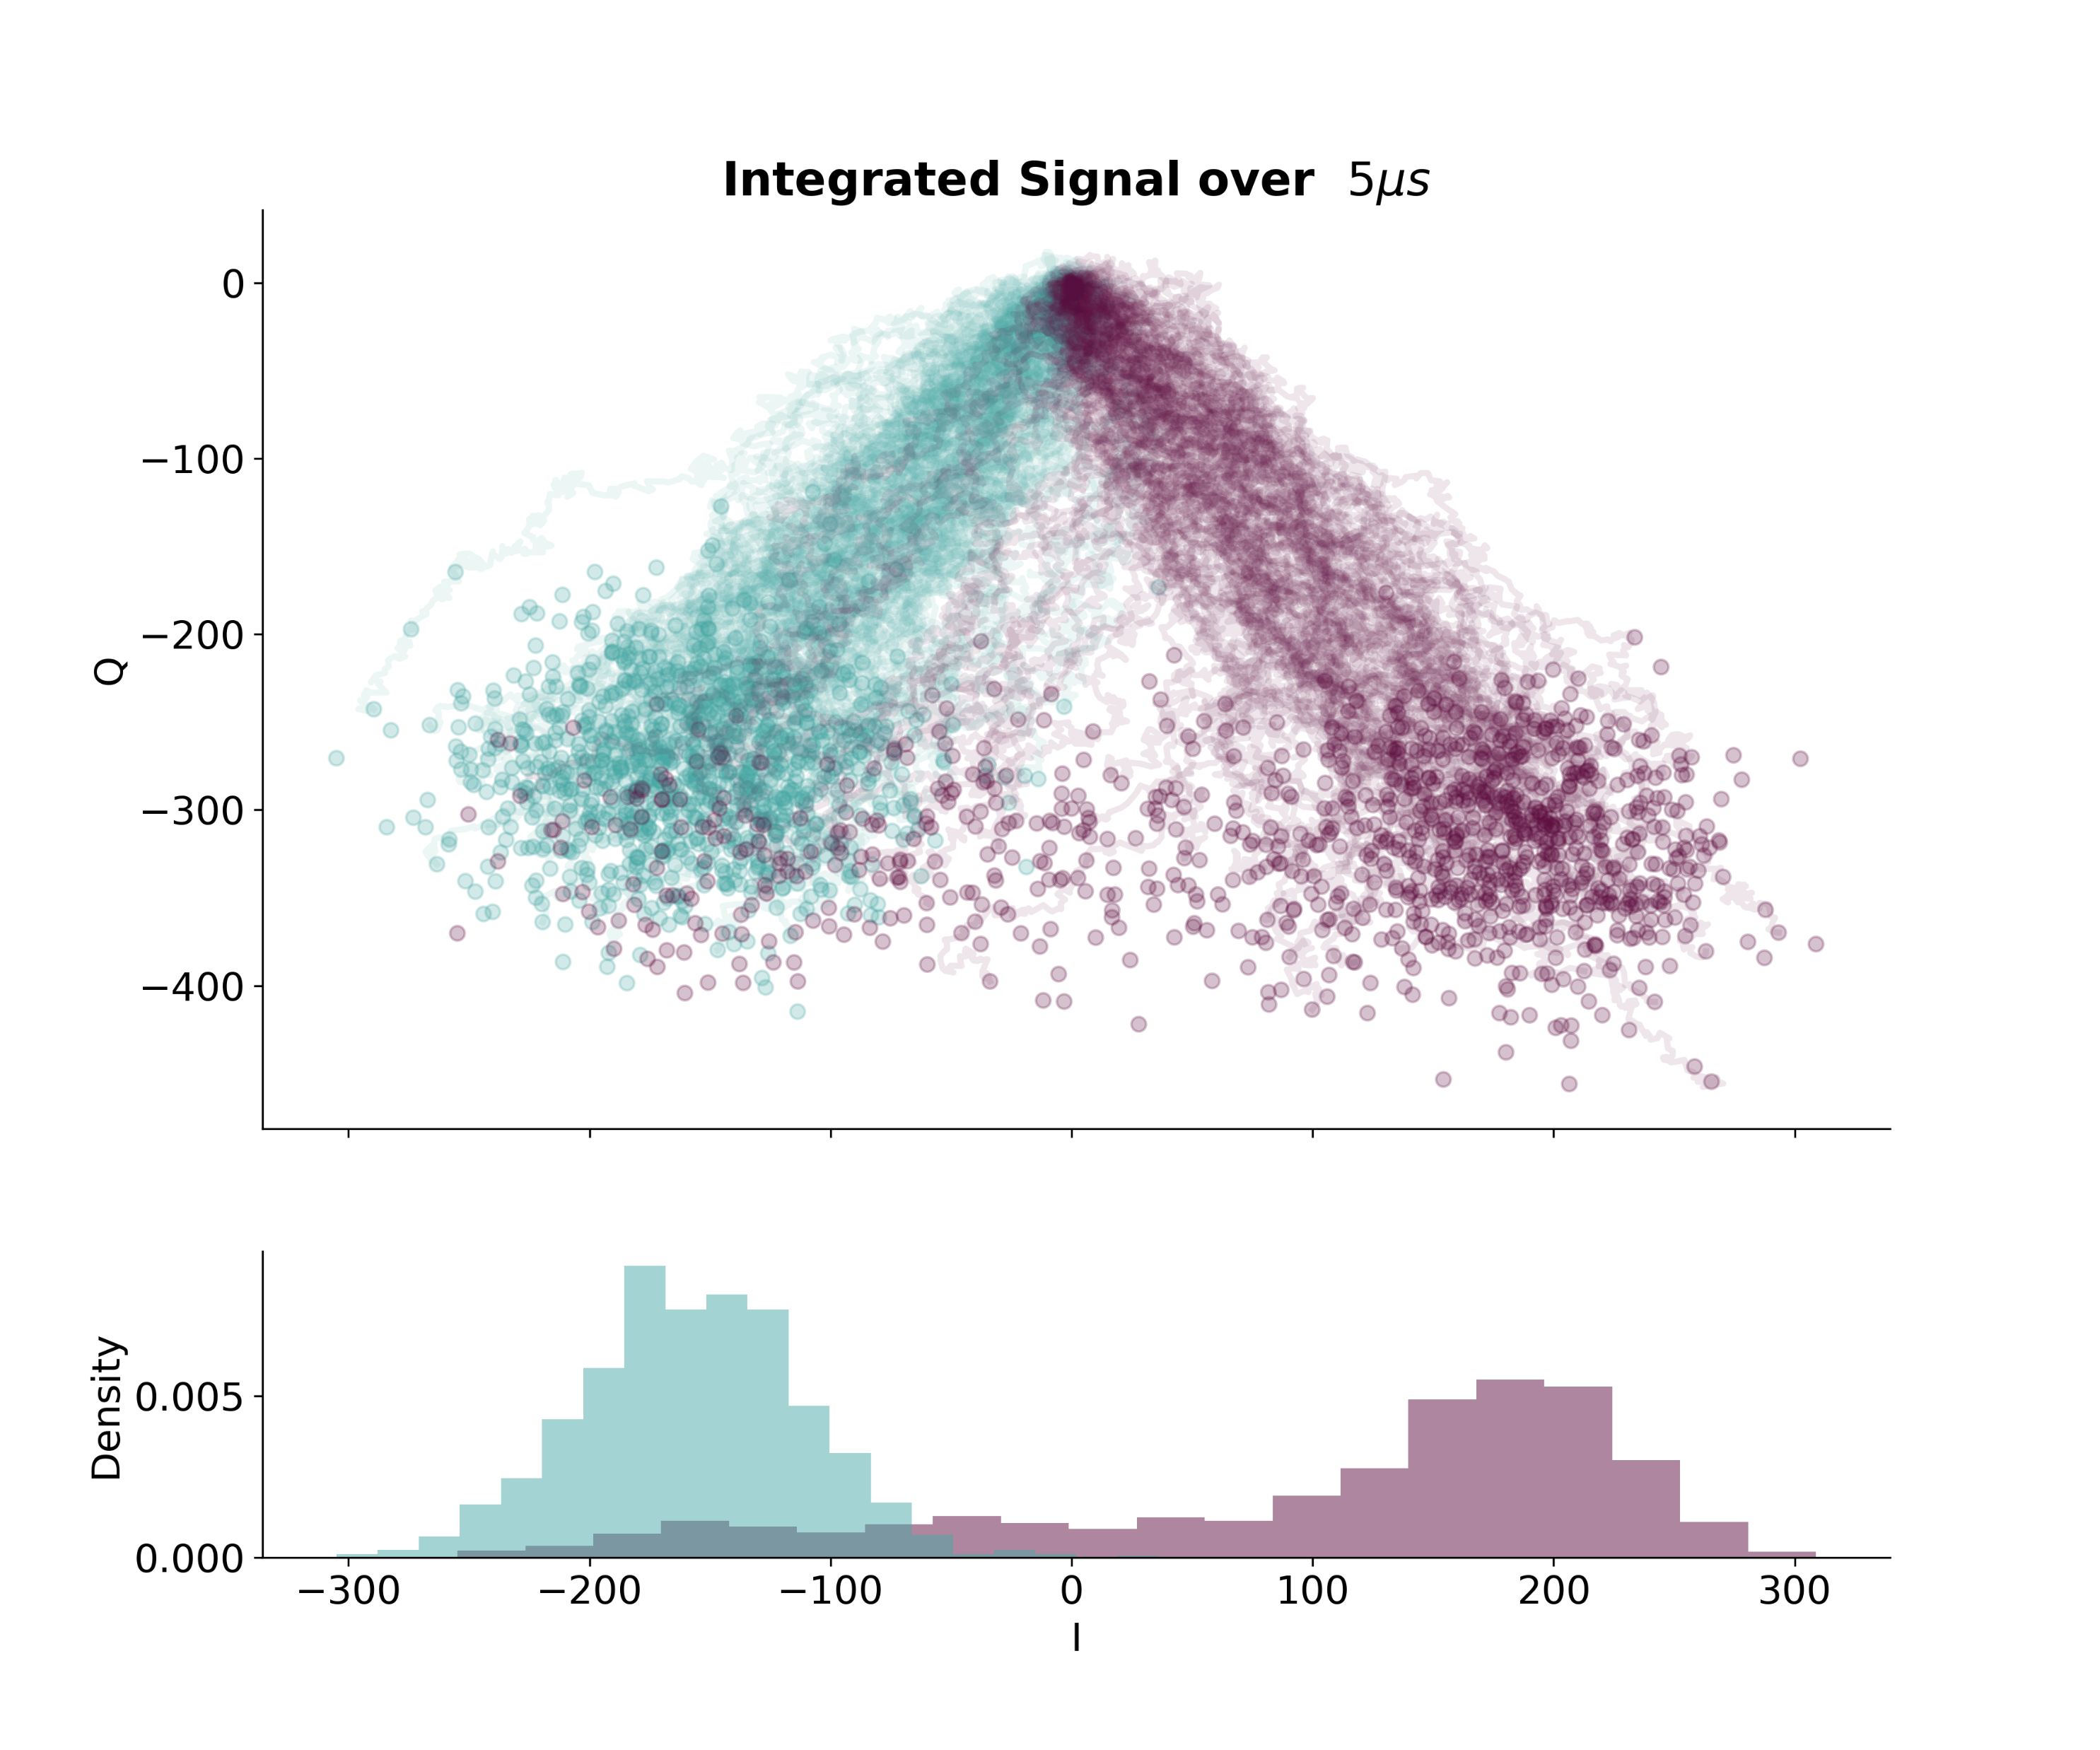
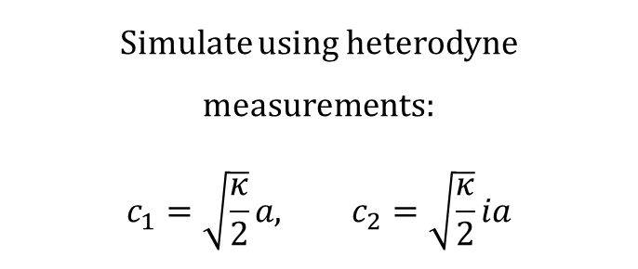
Stochastic Master Equation
Simulations
$$dρ=−i\left[H, ρ\right]dt+Σ_{n}𝒟\left[c_{n}\right]ρdt+Σ_{n}ℋ\left[c_{n}\right]ρdW$$
$$ℋ\left[c\right]ρ=\sqrt{η}\left(cρ+ρc^{†}−\left\langle c+c^{†}\right\rangle ρ\right)$$
$$dr=\frac{\left\langle c+c^{†}\right\rangle }{2}dt+\frac{1}{2\sqrt{η}}dW$$
Simulate using heterodyne measurements:
$$c_{1}=\sqrt{\frac{κ}{2}}a, c_{2}=\sqrt{\frac{κ}{2}}ia$$

Slide 16
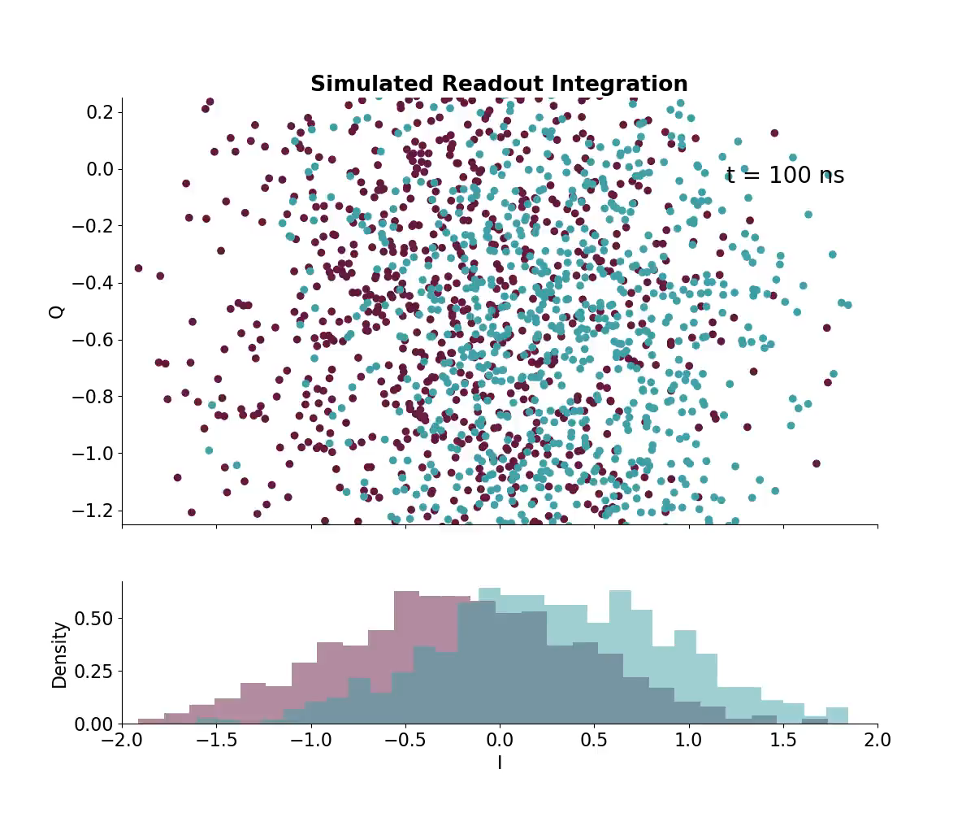
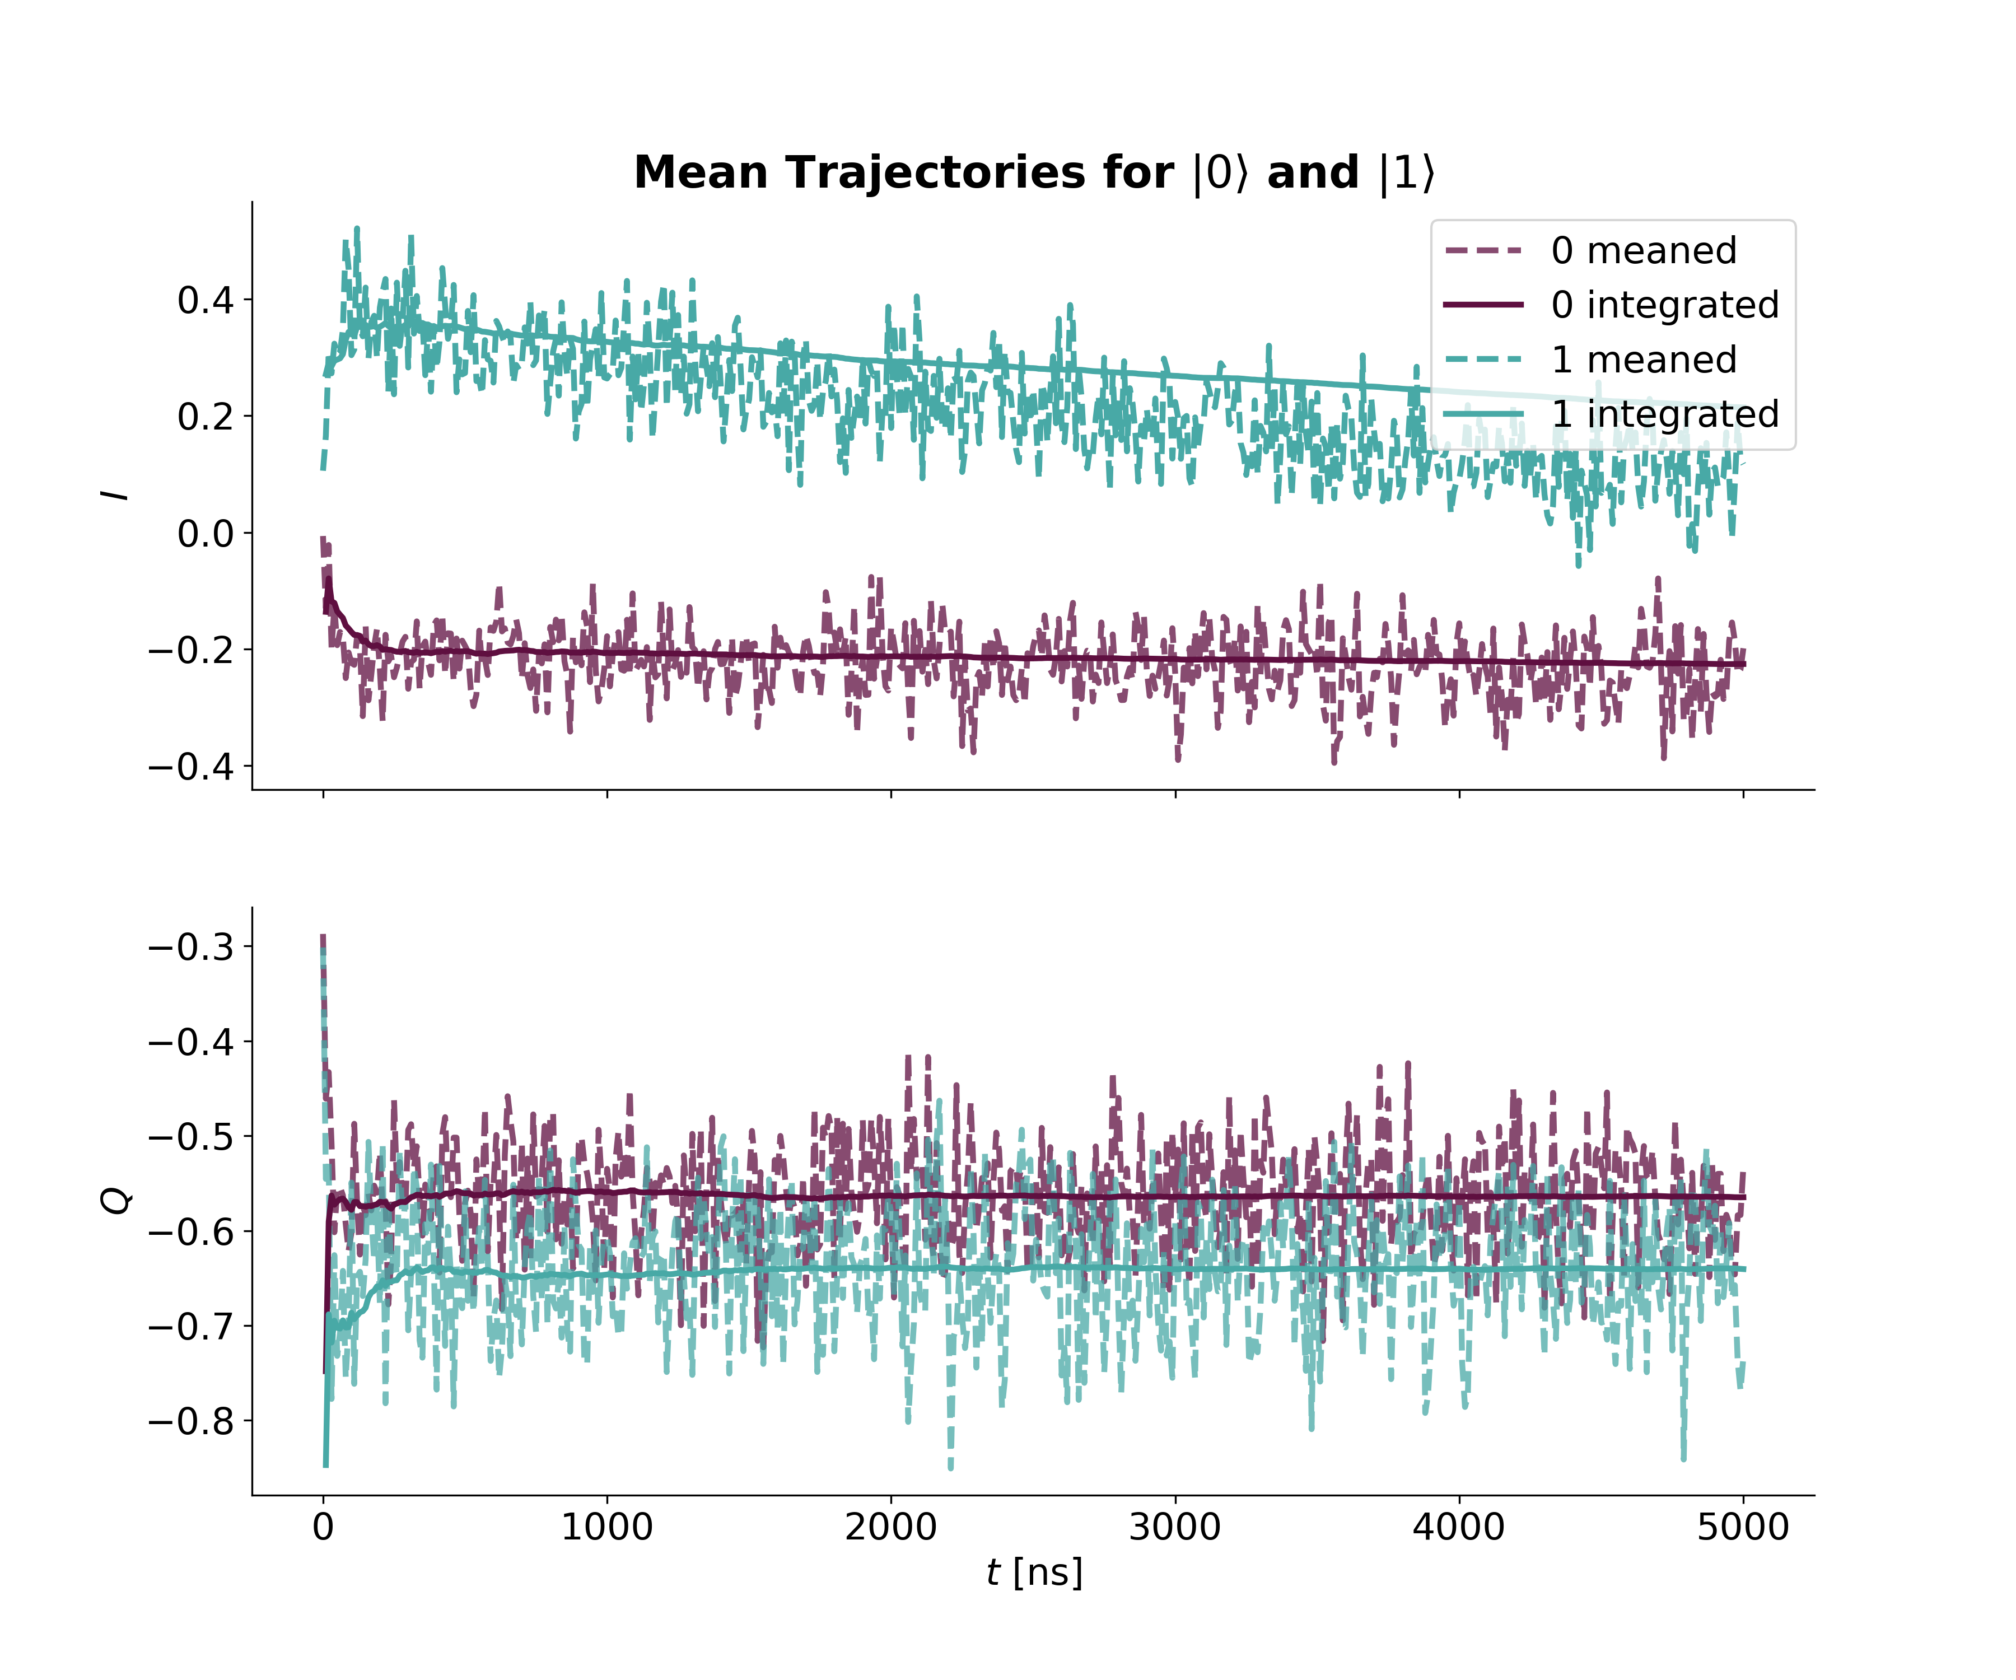
Integration Weights
Readout Simulation and Strategies
$$dρ=−i\left[H, ρ\right]dt+Σ_{n}𝒟\left[c_{n}\right]ρdt+Σ_{n}ℋ\left[c_{n}\right]ρdW$$

Slide 17
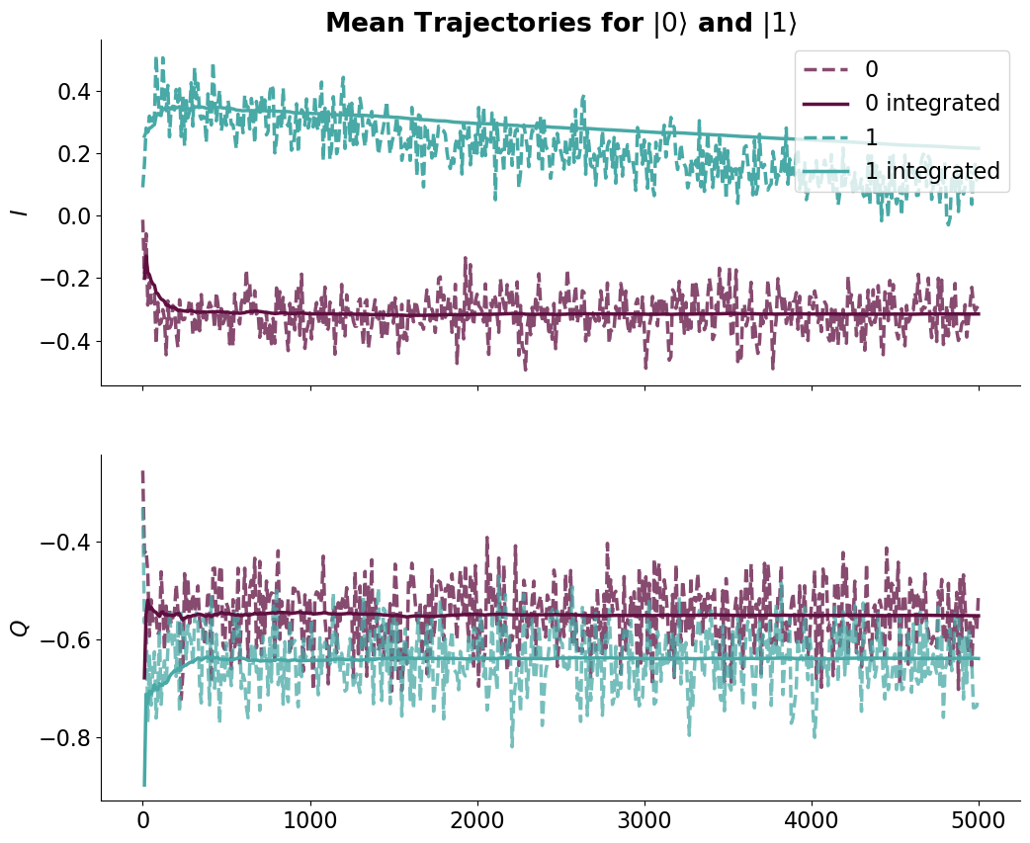
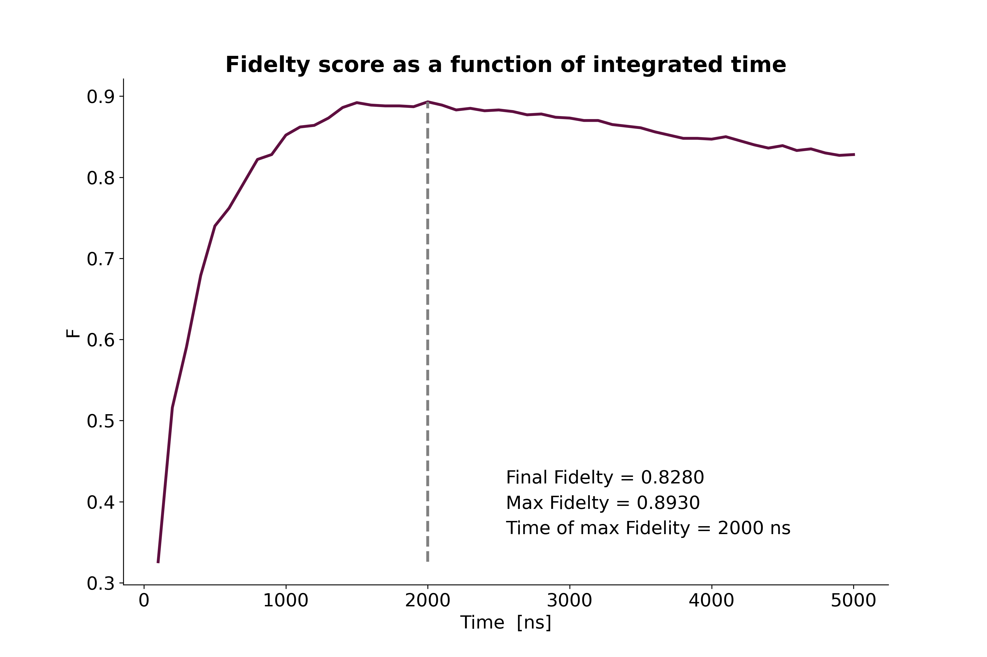
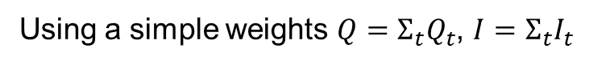
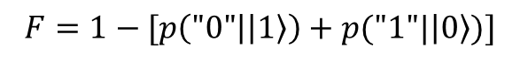
Integration Weights
Readout Simulation and Strategies
$$dρ=−i\left[H, ρ\right]dt+Σ_{n}𝒟\left[c_{n}\right]ρdt+Σ_{n}ℋ\left[c_{n}\right]ρdW$$
Using a simple weights $Q=Σ_{t}Q_{t}$, $I=Σ_{t}I_{t}$
$$F=1−[p\left("0" | \left|1\right\rangle \right)+p("1"|\left|0\right\rangle )]$$

Slide 18
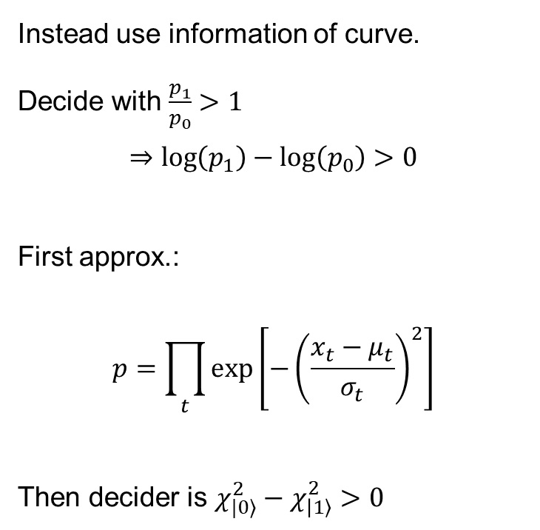
Integration Weights
Readout Simulation and Strategies
$$dρ=−i\left[H, ρ\right]dt+Σ_{n}𝒟\left[c_{n}\right]ρdt+Σ_{n}ℋ\left[c_{n}\right]ρdW$$
Instead use information of curve.
Decide with $\frac{p_{1}}{p_{0}}>1$
$$⇒\log\left(p_{1}\right)−\log\left(p_{0}\right)>0$$
First approx.:
$$p=\prod_{t}{\exp\left[−{\left(\frac{x_{t}−μ_{t}}{σ_{t}}\right)}^{2}\right]}$$
Then decider is $χ_{|0⟩}^{2}−χ_{\left|1\right\rangle }^{2}>0$

Slide 19
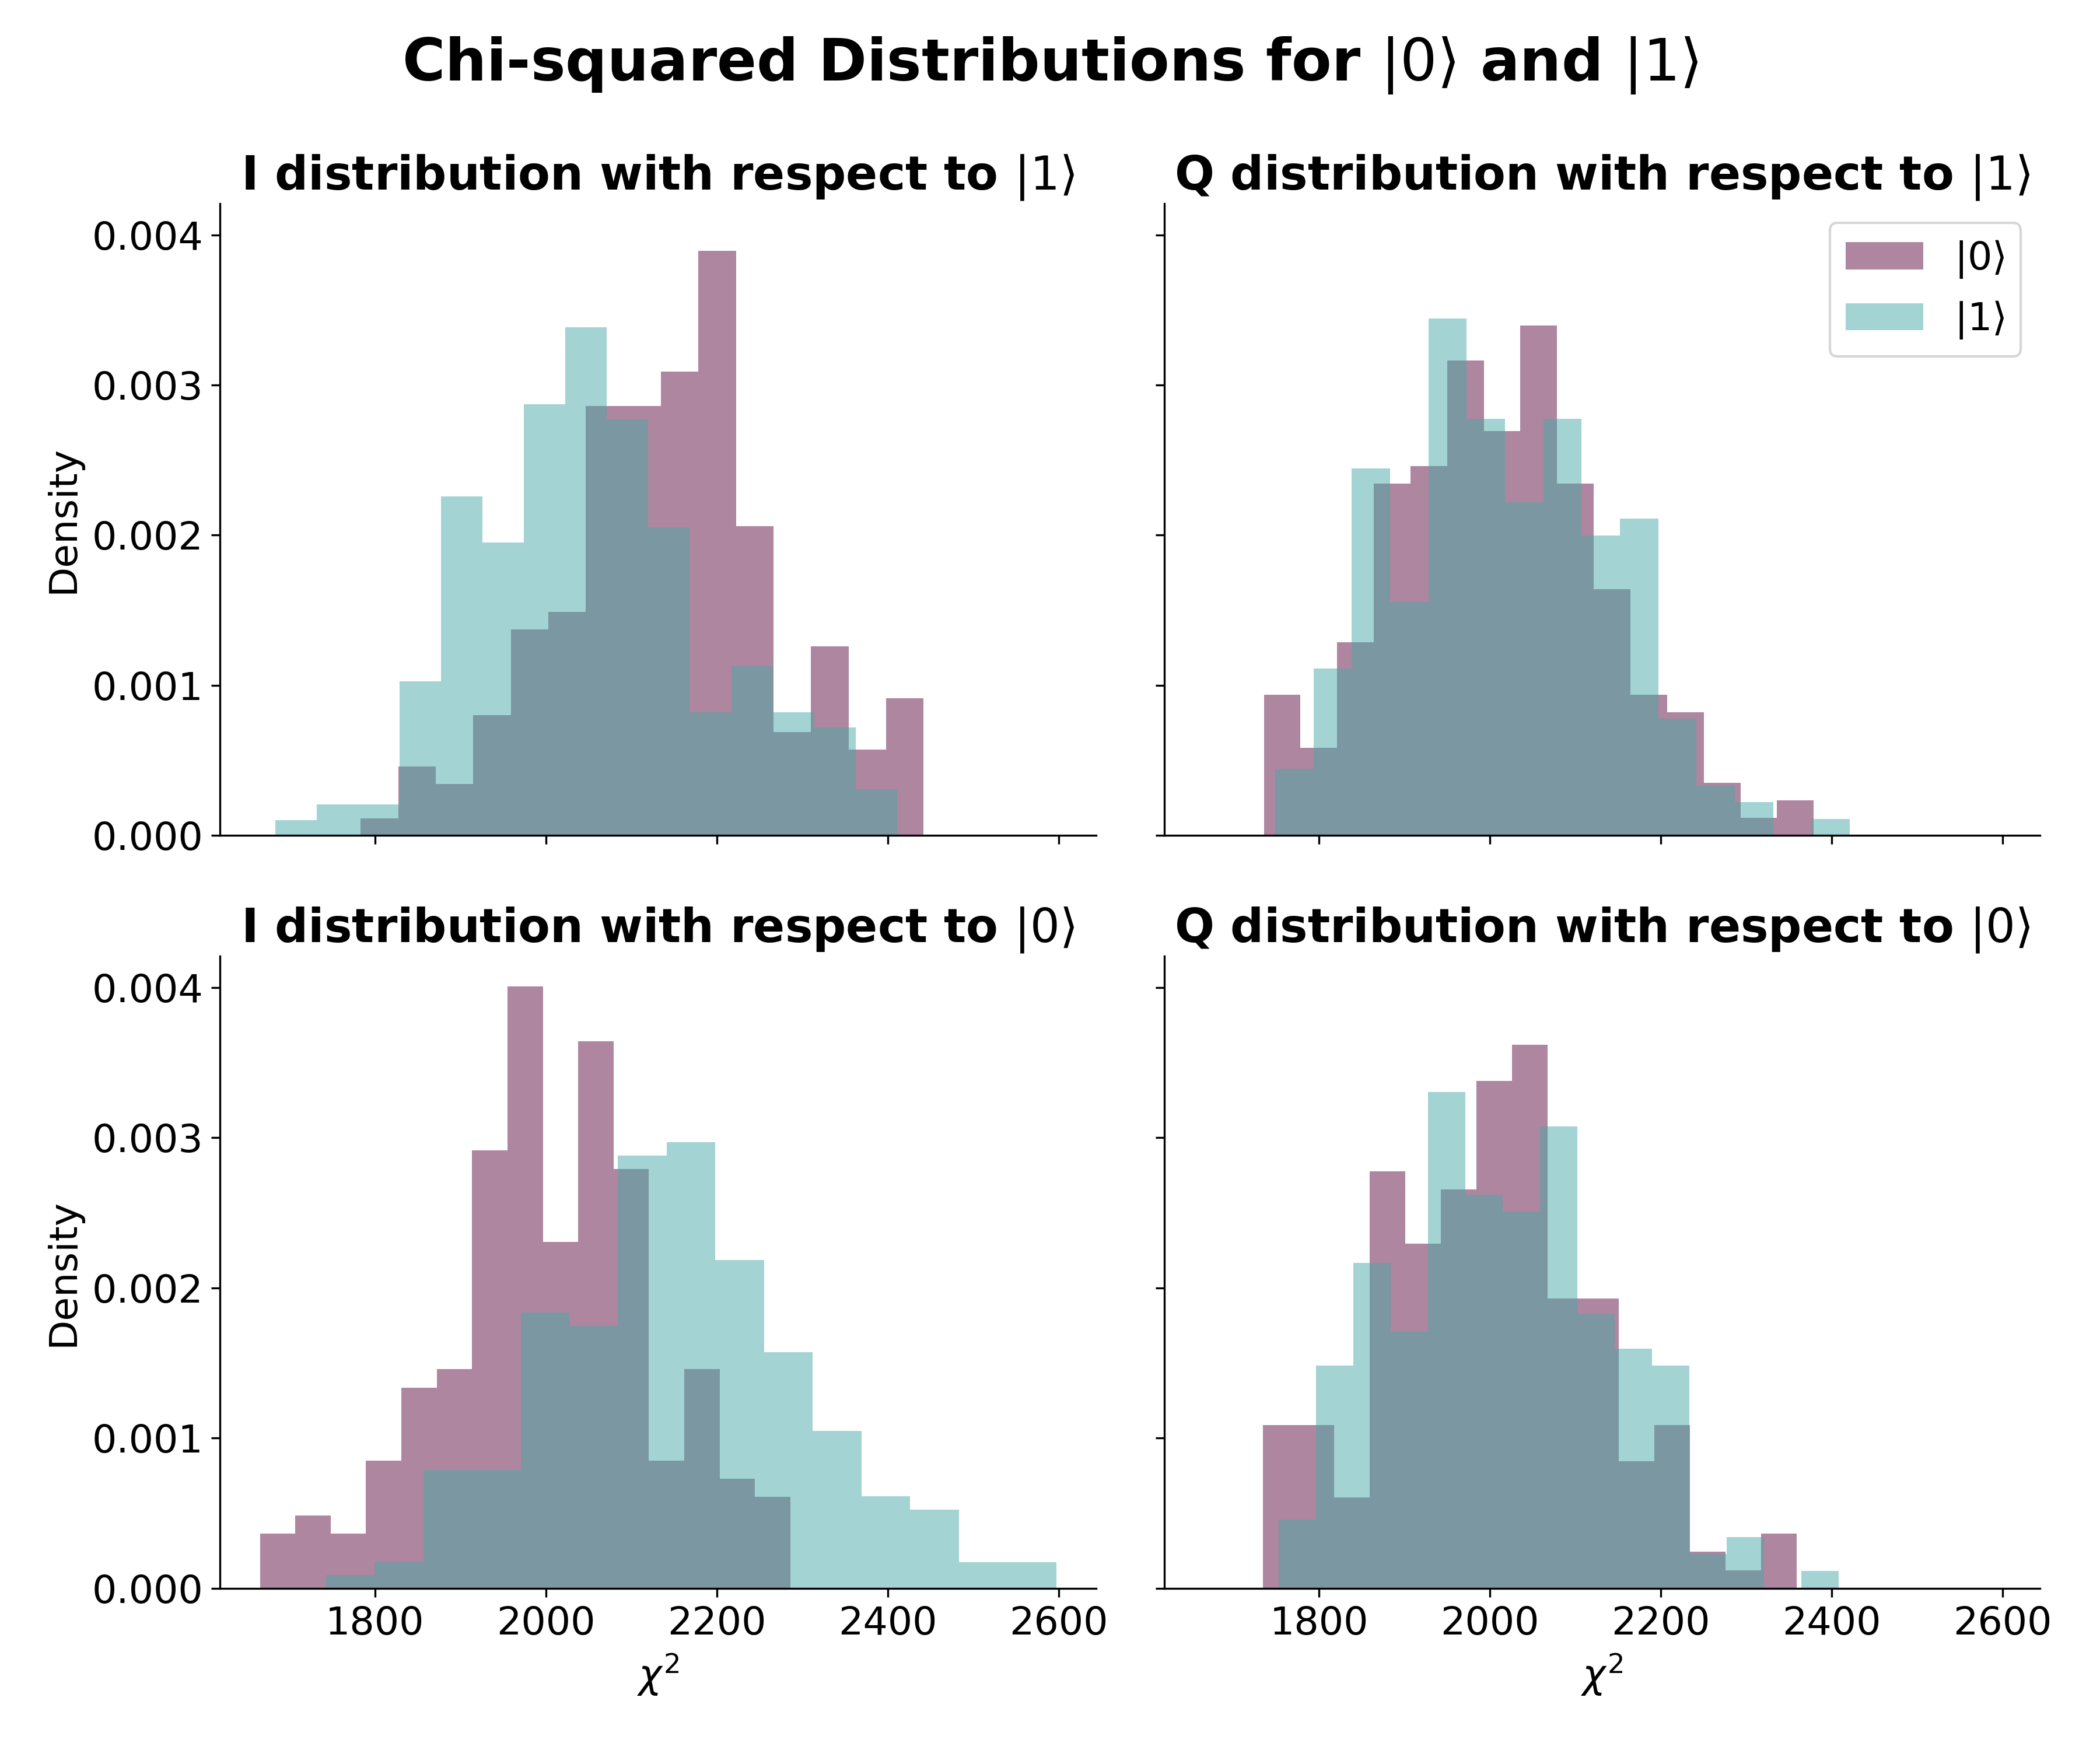
Integration Weights
Readout Simulation and Strategies
$$dρ=−i\left[H, ρ\right]dt+Σ_{n}𝒟\left[c_{n}\right]ρdt+Σ_{n}ℋ\left[c_{n}\right]ρdW$$
Instead use information of curve.
Decide with $\frac{p_{1}}{p_{0}}>1$
$$⇒\log\left(p_{1}\right)−\log\left(p_{0}\right)>0$$
First approx.:
$$p=\prod_{t}{\exp\left[−{\left(\frac{x_{t}−μ_{t}}{σ_{t}}\right)}^{2}\right]}$$
Then decider is $χ_{|0⟩}^{2}−χ_{\left|1\right\rangle }^{2}>0$

Slide 20
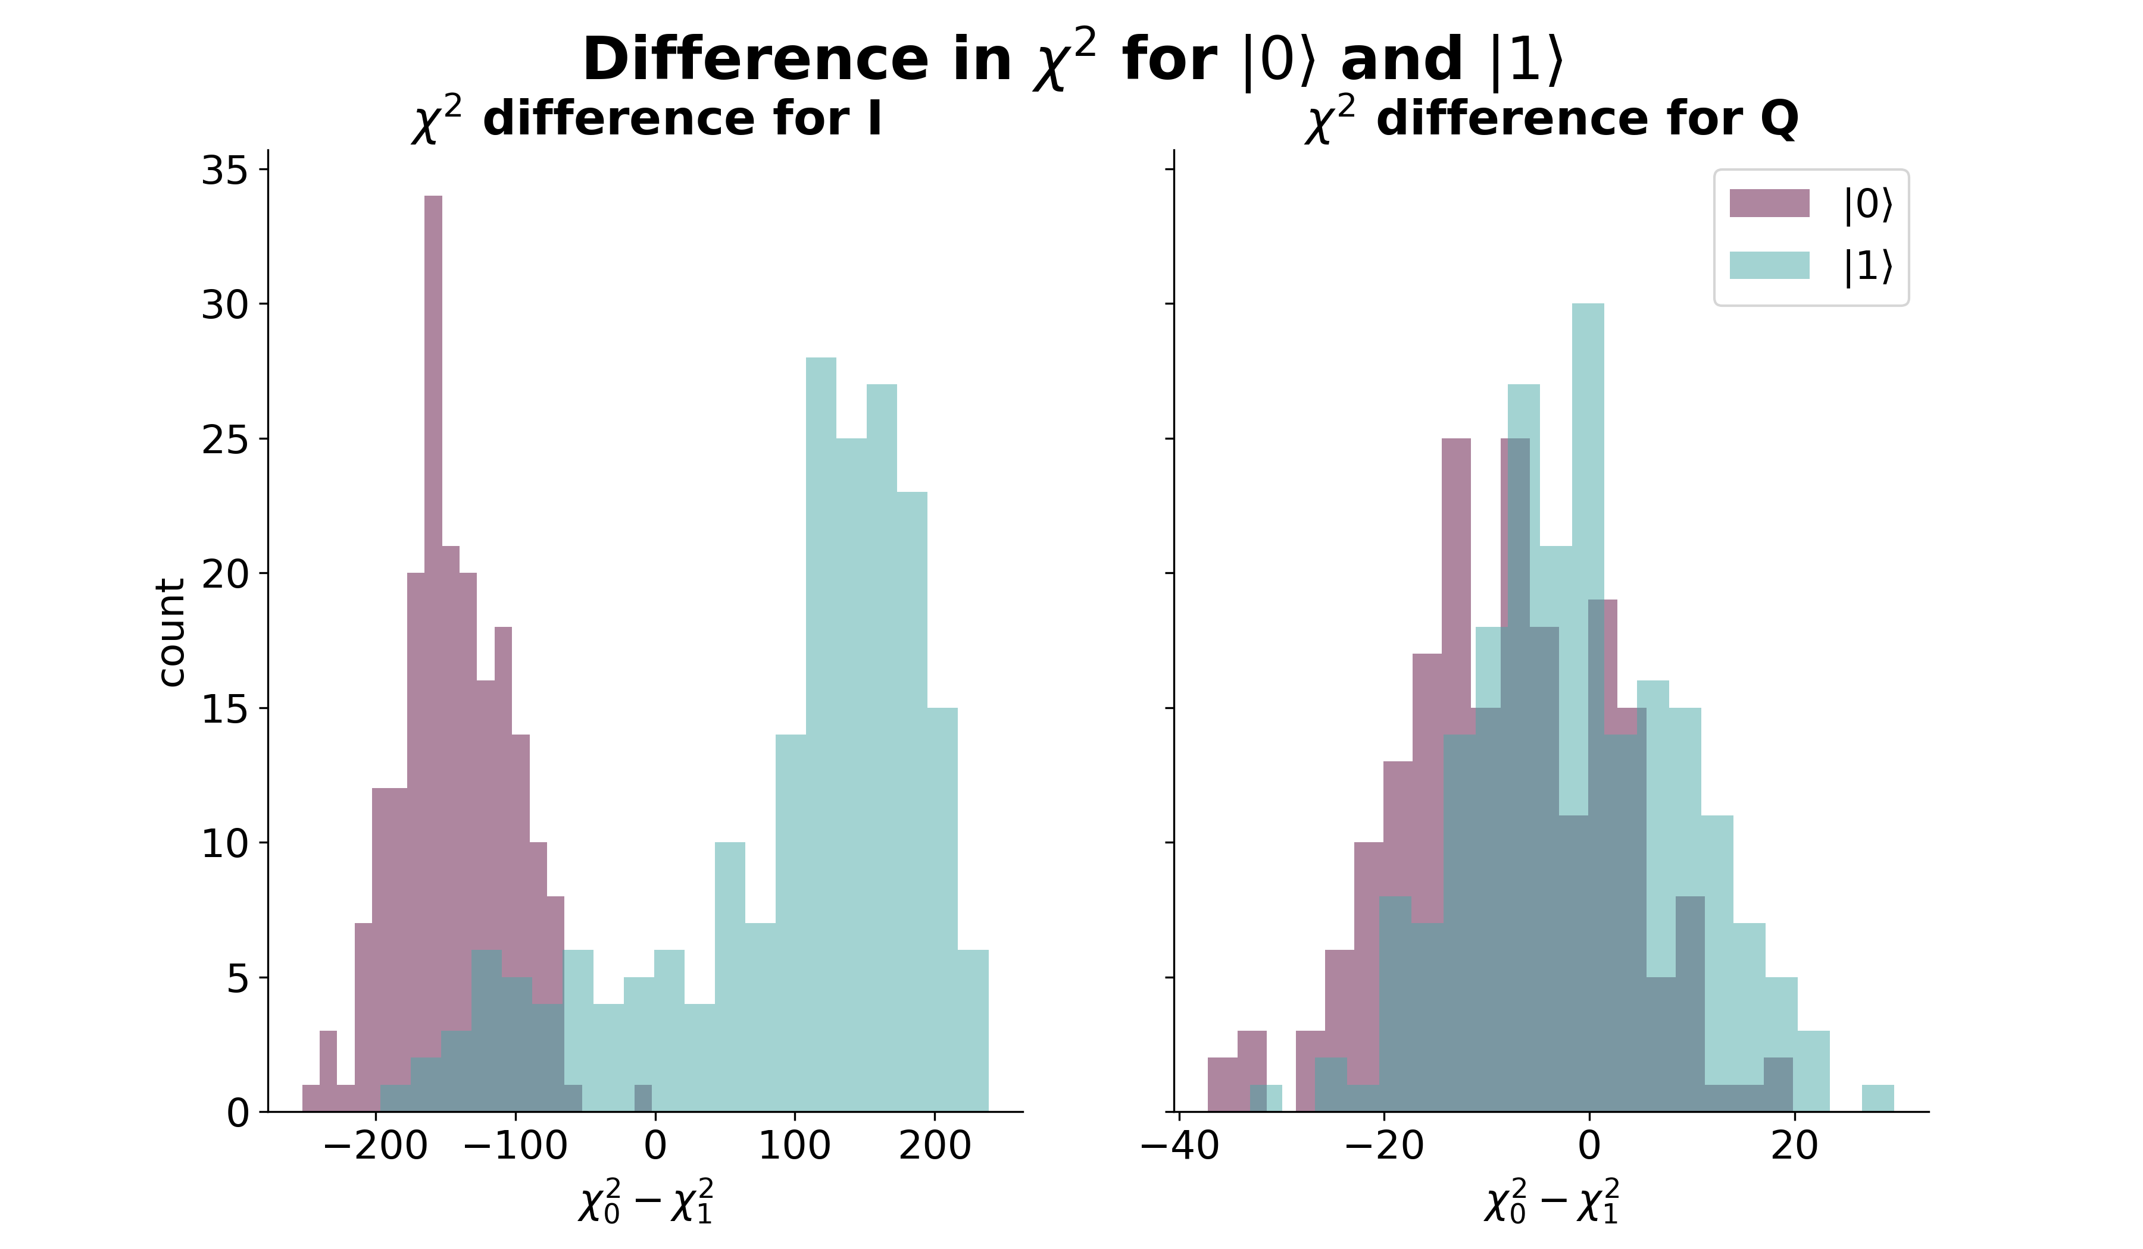
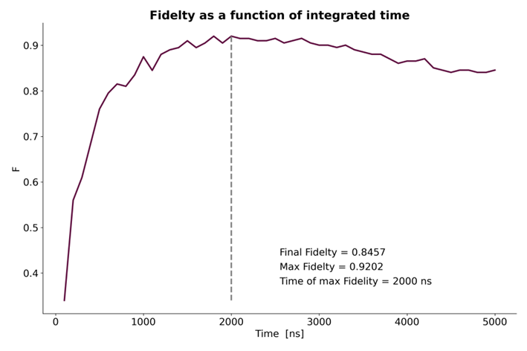

Integration Weights
Readout Simulation and Strategies
$$dρ=−i\left[H, ρ\right]dt+Σ_{n}𝒟\left[c_{n}\right]ρdt+Σ_{n}ℋ\left[c_{n}\right]ρdW$$
Compared to $\max\left(F\right)=0.893$ for simple sum

